Slide 1
The Works of Mercy:
Divine Mercy in the Activity of the Church
Rev. Mark N.P. Salas
Healing and Renewal Conference 2015
pancratius@hotmail.com
915-328-3844

Slide 2
Matthew 25, 31-46
The Judgment of the Nations:
“When the Son of Man comes in his glory, and all the angels with him, he will sit upon his glorious throne, and all the nation will be assembled before him. And he will separate them one from another, as a shepherd separates the sheep from the goats. He will place the sheep on his right and the goats on his left. Then the king will say to those on his right, ‘Come, you who are blessed by my Father. Inherit the kingdom prepared for you from the foundation of the world. For I was hungry and you gave me food, I was thirsty and you gave me drink, a stranger and you welcomed me, naked and you clothed me, ill and you cared for me, in prison and you visited me.’

Slide 3
Matthew 25, 31-46
The Judgment of the Nations:
Then the righteous will answer him and say, ‘Lord, when did we see you hungry and feed you, or thirsty and give you drink? When did we see you a stranger and welcome you, or naked and clothe you? When did we see you ill or in prison, and visit you?’ And the king will say to them in reply, ‘Amen, I say to you, whatever you did for one of these least brothers of mine, you did for me.’ Then he will say to those on his left, ‘Depart from me, you accursed, into the eternal fire prepared for the devil and his angels. For I was hungry and you gave me no food, I was thirsty and you gave me no drink, a stranger and you gave me no welcome, naked and you gave me no clothing, ill and in prison, and you did not care for me.’ Then they will answer and say, ‘Lord, when did we see you hungry or thirsty or a stranger or naked or ill or in prison, and not minister to your needs?’ He will answer them, ‘Amen, I say to you, what you did not do for one of these least ones, you did not do for me.’ And these will go off to eternal punishment, but the righteous to eternal life.”

Slide 4
Works of Mercy
Corporal:
Feed the Hungry
Quench the Thirsty
Clothe the Naked
Harbor the Harborless
Visit the Sick
Ransom the Captive
Bury the Dead

Slide 5
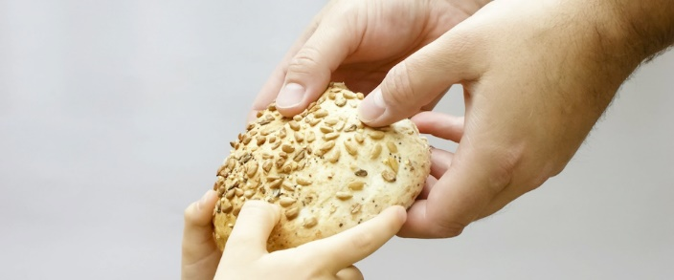
Feeding the Hungry:
I am the bread of life come down

Slide 6
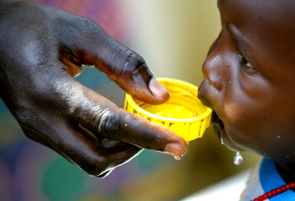
Quench the Thirsty:
He who drinks the Water that I will give

Slide 7
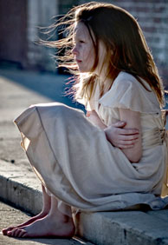
Clothe the Naked:
What good is it to say,
“Stay warm and well fed…”

Slide 8
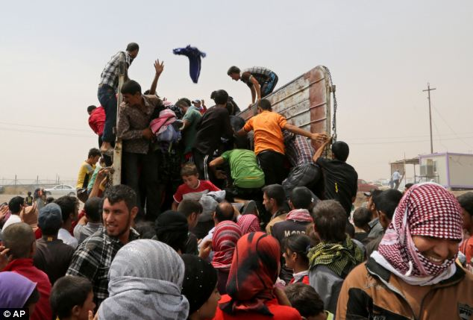
Harbor the Harbourless:
For your too were strangers in a foreign land

Slide 9
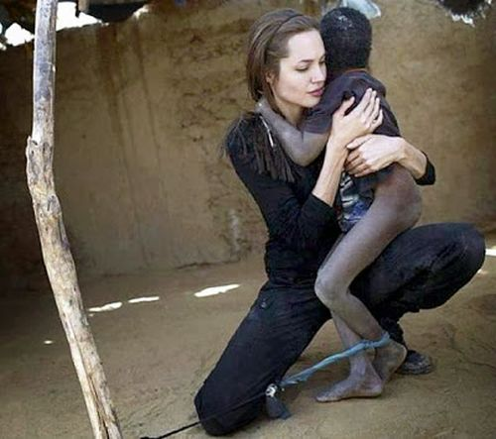
Visit the Sick:
Our Guardians watch over us as a nurse over the sick

Slide 10
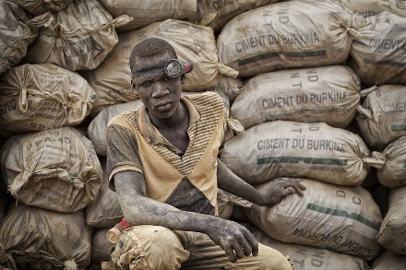
Ransom the Captive:
What good is it to gain the whole world in forfeit of your soul?

Slide 11
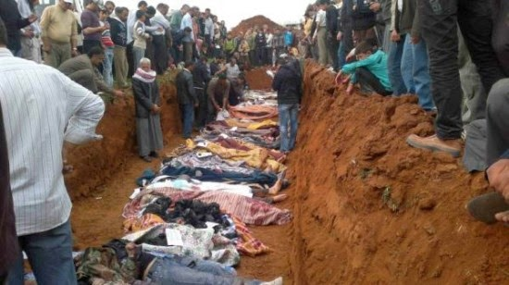
Bury the Dead: but if it dies and is buried it shall bear much fruit, ten or a hundred times

Slide 12
Works of Mercy
Spiritual:
Instruct Ignorance
Counsel Doubt
Admonish Sin
Patiently Bear Wrongs
Forgive Offences
Comfort Affliction
Pray for Living and Dead

Slide 13
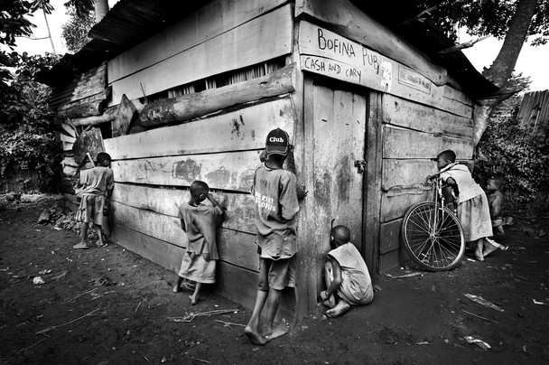
Instruct Ignorance:
Knowledge is stored in memory,
Memory is Identity

Slide 14
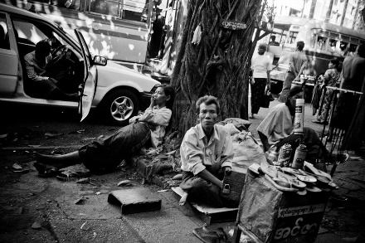
Counsel Doubt:
Take heart, it is I the Lord your God

Slide 15
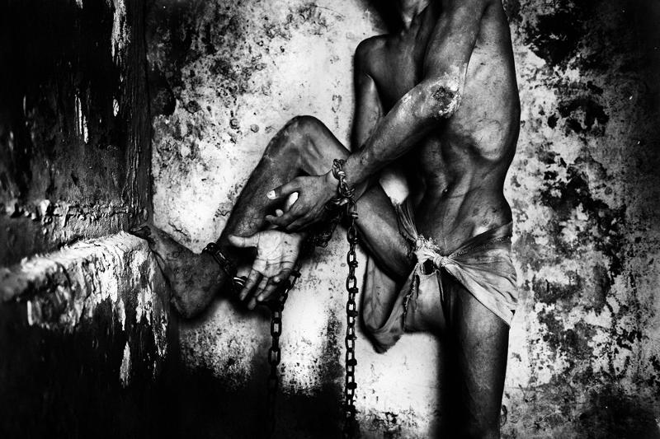
Admonish Sin:
Father may they be ONE
Accountability is key light of bad behavior, broken commitments, or violated expectations

Slide 16
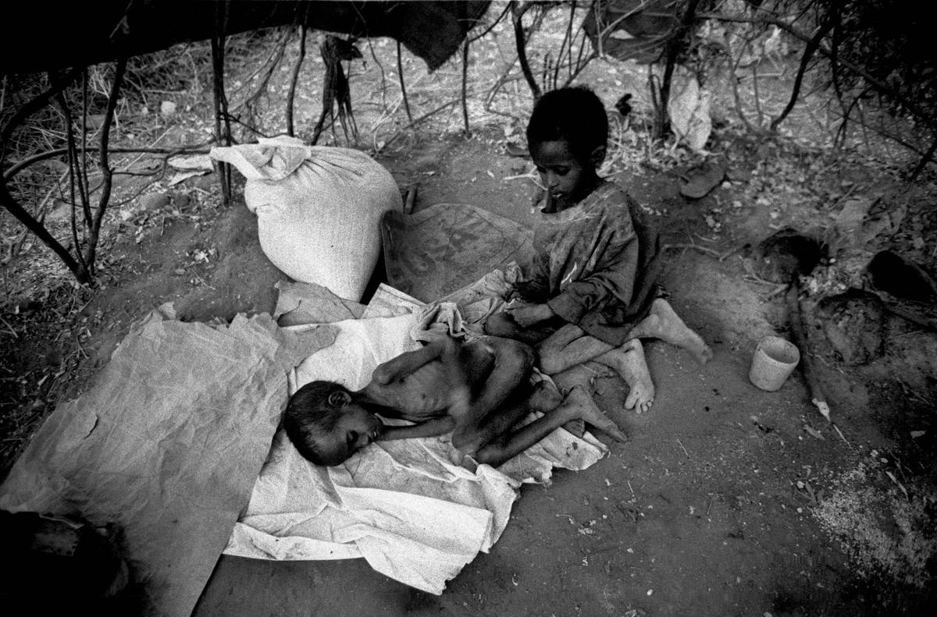
Patiently Bear Wrongs:
Forgiveness and Reconciliation are to different things
Patience and curiosity are not permissiveness, but rather respect and mutual purpose.

Slide 17
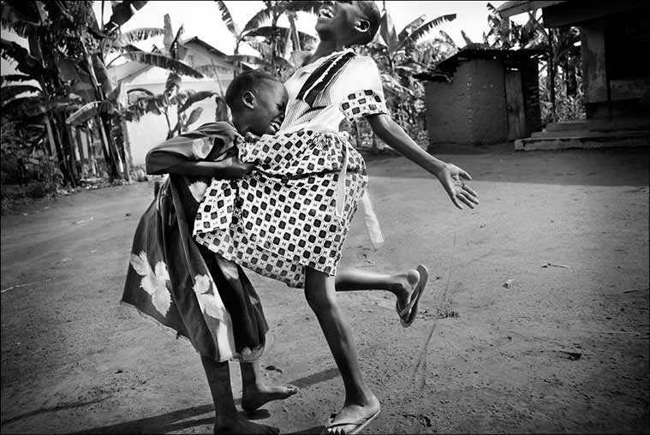
Forgive Offences:
Forgive for your sake, not theirs
Ask yourself as an observer, without judgment:
Why would an intelligent, good, and lovable person behave thusly?

Slide 18
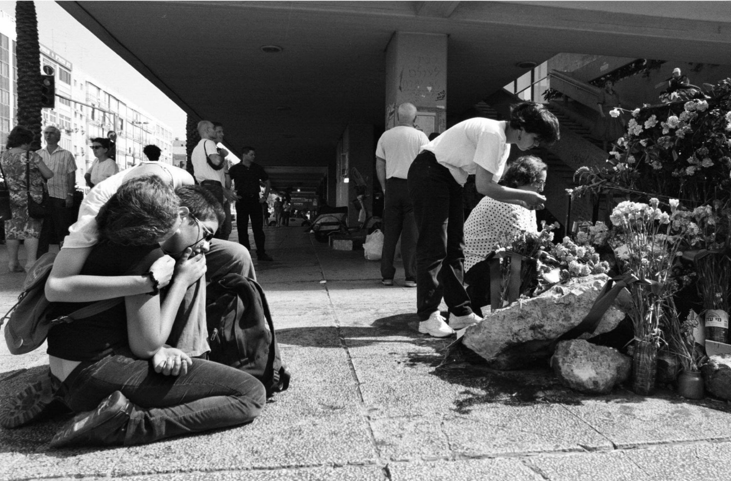
Comfort the Afflicted:
I am resolved to know nothing but Christ, and him Crucified
True conversations maintains safety, respect and mutual purpose without imposition or disengagement.

Slide 19
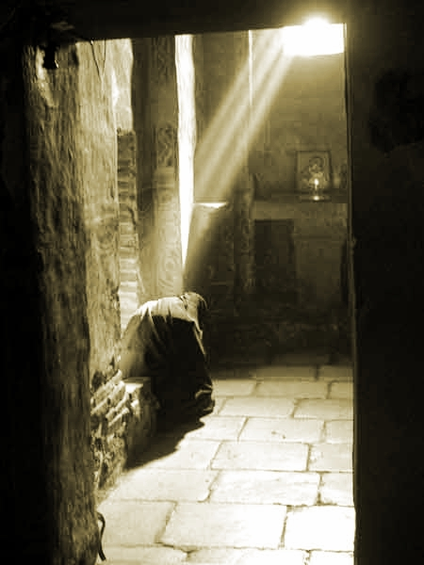
Pray for the Living and the Dead:
The God we hope in is the Image we become

Slide 20
Matthew 25, 31-46
The Judgment of the Nations:
“When the Son of Man comes in his glory, and all the angels with him, he will sit upon his glorious throne, and all the nation will be assembled before him. And he will separate them one from another, as a shepherd separates the sheep from the goats. He will place the sheep on his right and the goats on his left. Then the king will say to those on his right, ‘Come, you who are blessed by my Father. Inherit the kingdom prepared for you from the foundation of the world. For I was hungry and you gave me food, I was thirsty and you gave me drink, a stranger and you welcomed me, naked and you clothed me, ill and you cared for me, in prison and you visited me.’

Slide 21
Matthew 25, 31-46
The Judgment of the Nations:
Then the righteous will answer him and say, ‘Lord, when did we see you hungry and feed you, or thirsty and give you drink? When did we see you a stranger and welcome you, or naked and clothe you? When did we see you ill or in prison, and visit you?’ And the king will say to them in reply, ‘Amen, I say to you, whatever you did for one of these least brothers of mine, you did for me.’ Then he will say to those on his left, ‘Depart from me, you accursed, into the eternal fire prepared for the devil and his angels. For I was hungry and you gave me no food, I was thirsty and you gave me no drink, a stranger and you gave me no welcome, naked and you gave me no clothing, ill and in prison, and you did not care for me.’ Then they will answer and say, ‘Lord, when did we see you hungry or thirsty or a stranger or naked or ill or in prison, and not minister to your needs?’ He will answer them, ‘Amen, I say to you, what you did not do for one of these least ones, you did not do for me.’ And these will go off to eternal punishment, but the righteous to eternal life.”

Slide 22
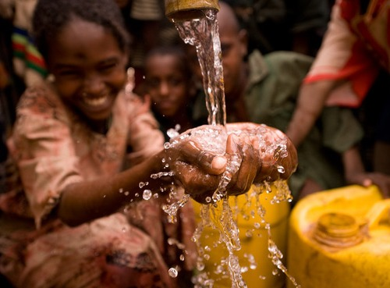
The Works of Mercy:
Divine Mercy in the Activity of the Church
Rev. Mark N.P. Salas
Healing and Renewal Conference 2015
pancratius@hotmail.com
915-328-3844

